Slide 1


SHIELD INSURANCE
ANALYSIS
MAYUR PAWAR
Data Analyst Intern
AtliQ Technologies

Slide 2
TABLE OF CONTENTS
About Company
Data Sets and Data Model
Regional Presence
Multi-Channel Approach
Problem Statement
Dashboard
Insights
Recommendations

Slide 3
ABOUT COMPANY
Shield Insurance offers a wide range of policies to suit the needs of people across all age groups.
Their focus is on providing affordable and flexible solutions that help customers feel secure and protected.
With a strong customer-first approach, they ensure their plans are simple, easy to understand, and personalized to fit different stages of life.

Slide 4
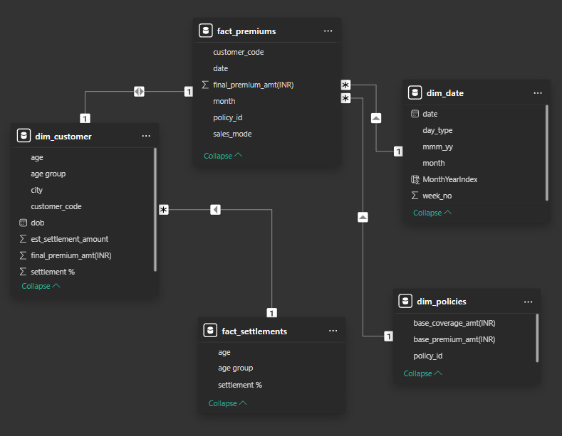


DATA SETS AND DATA MODEL
Dim_customer
Dim_date
Dim_policies
Fact_premiums
Fact_settlements

Slide 5
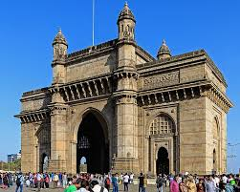
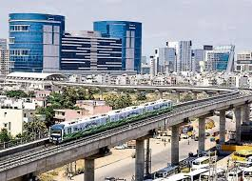
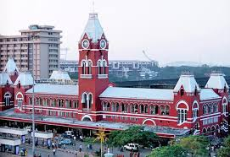
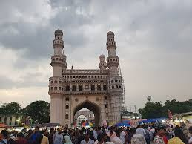
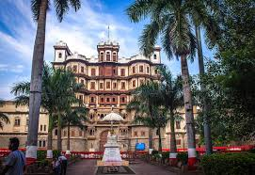
REGIONAL PRESENCE - CITIES
MUMBAI
DELHI NCR
CHENNAI
HYDERABAD
INDORE
MULTI-CHANNEL APPROACH
OFFLINE
ONLINE
DIRECT
AGENT
APP
WEBSITE

Slide 6
PROBLEM STATEMENT
Shield Insurance aims to enhance its data-driven decisions by implementing a dashboard that delivers clear and actionable insights.
To explore a partnership with AtliQ Technologies, they have proposed a pilot project to assess our capabilities.
This project will help them evaluate how effectively we can meet their requirements before moving forward with a full-scale implementation.
The outcome of this pilot will play a key role in determining the possibility of a larger, long-term collaboration.

Slide 7
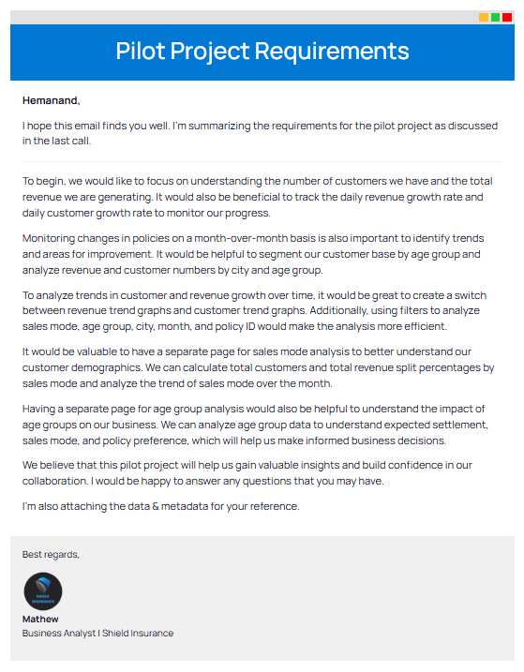
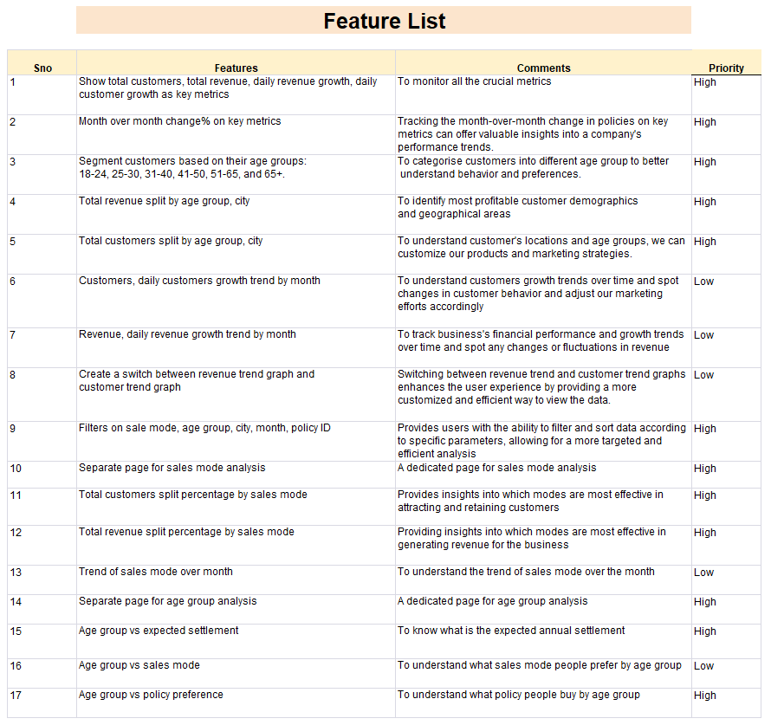

Slide 8
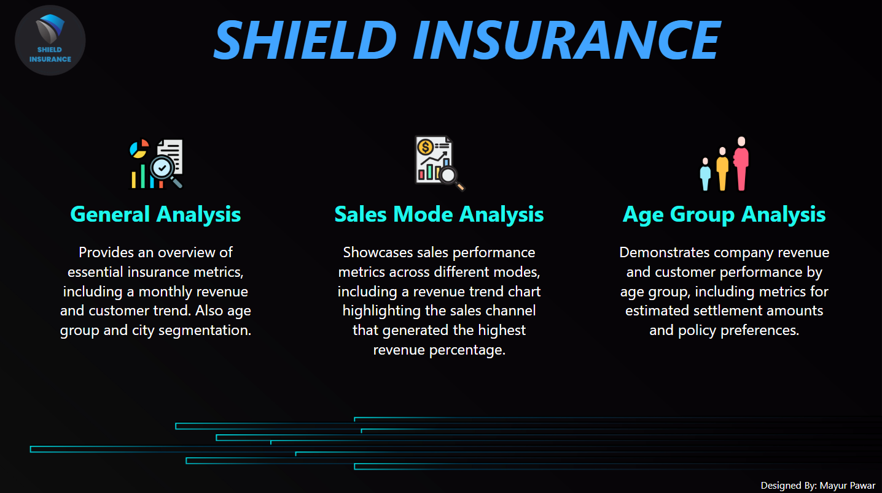
DASHBOARD
POWER BI DASHBOARD

Slide 9
INSIGHTS
Revenue and Customer Trends: March 2023 recorded the highest revenue and customers, while November 2022 saw the lowest daily revenue and customer growth.
Regional Revenue: Delhi NCR region led with the highest revenue, whereas Indore contributed the least in both revenue and customer base.
Top Age Group: The 31-40 age group generated the highest revenue and had the largest number of customers.
Lower-Contributing Age Groups: Customers aged 18-24 and 25-30 contributed the least, representing just 8.67% of total revenue.
Sales Channel Performance: Offline agent channels performed best, generating 55.67% of the revenue and serving 55.41% of customers.
Top Policy: Policy ID - POL2005HEL generated the highest revenue despite being held by only 7.33% of customers.
Lower-Revenue Policies: Policy IDs - POL4321HEL and POL4331HEL collectively contributed just 5.96% of the revenue while covering 30.43% of customers.
Claims Settlement: Customers aged 31-40 had the highest settlement amounts, whereas those aged 18-24 and 25-30 had the lowest settlement needs.

Slide 10
RECOMMENDATIONS
Boost Indore’s Growth: Analyze local challenges and implement targeted marketing strategies to increase revenue and customer growth in Indore. Consider personalized offers and campaigns that appeal to the regional audience.
Maximize Delhi NCR’s Potential: Since Delhi NCR is the highest revenue-generating region, focus on offering tailored insurance plans for different age groups to maintain and expand the customer base.
Engage Younger Customers: Investigate why customers aged 18-30 show less interest in purchasing policies. Develop affordable and customized plans that meet their needs and financial situations to attract this age group.
Expand Online Sales Channels: Improve the website experience and invest in digital marketing campaigns to reach a wider audience. With most revenue coming from offline agents, there’s an opportunity to grow online sales significantly.
Promote High-Performing Policies: Focus on promoting high-revenue policies like POL2005HEL. Highlight their benefits through targeted campaigns to attract new customers and boost overall revenue.
Target Top-Selling Cities with Localized Strategies: Develop customized marketing campaigns for high-performing cities such as Delhi NCR, Mumbai, Bangalore, and Chennai. Focus on region-specific customer preferences and needs to create personalized offers, ensuring maximum engagement and improved sales in these key markets.

Slide 11
THANK YOU!

